Slide 1
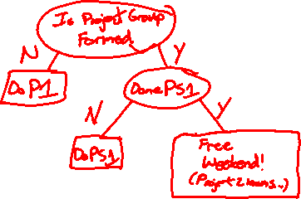
Decision Trees, Forests, and Linear & Logistic Regression
David Quigley
CSCI 5622
2021 Fall

Slide 2
Course Logistics
Project: Groups due 9/9!
Everyone submits an identical document
Project 2: Pitch and Project 2.1: Pitch Feedback instructions are now viewable on Canvas
Problem Sets: Problem Set 1 Due 9/16
Piazza is pretty active
If you have a question, it may have already been answered there!

Slide 3
Participation Activity: Naïve Bayes

Slide 4
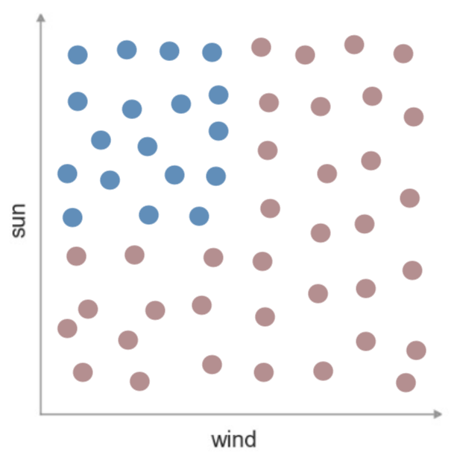
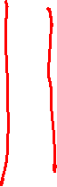

Decision Trees – Minimizing Entropy
We are creating a split to minimize the entropy of our set…
But really, we’re creating two sets, each with their own entropy, but a smaller number of samples in each.
D_{par} = Data found in Parent Node
D_{left} = Data found in Left Node
D_{right} = Data found in Right Node
I() = Impurity function (entropy)
x_{i} = feature for split

Slide 5
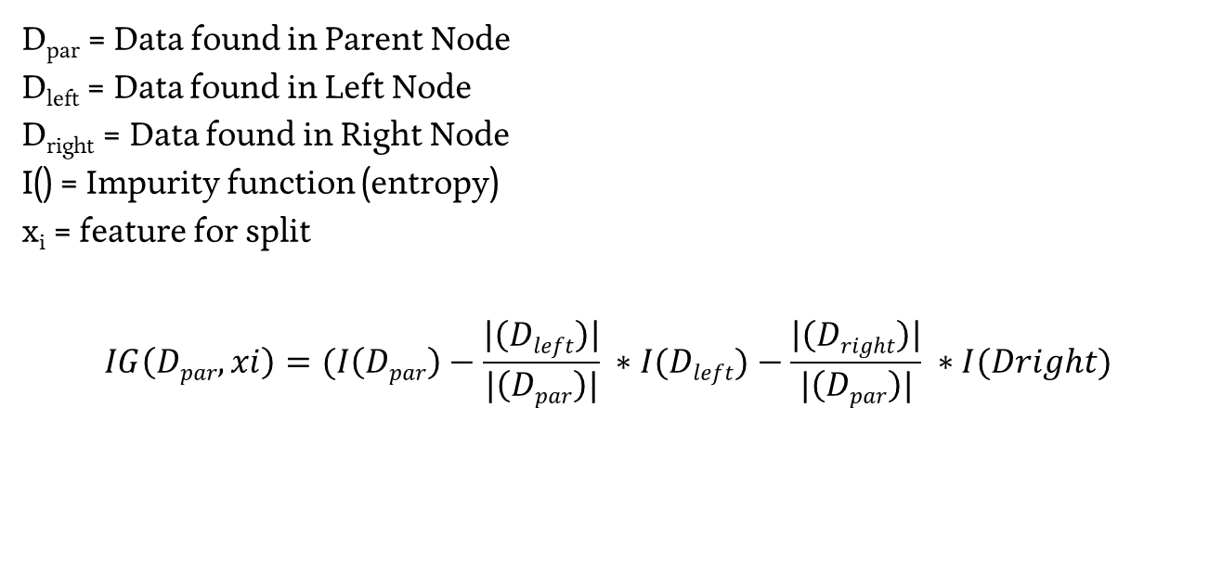
Decision Trees – Information Gain
D_{par} = Data found in Parent Node
D_{left} = Data found in Left Node
D_{right} = Data found in Right Node
I() = Impurity function (entropy)
x_{i} = feature for split
$$IG\left(Dpar,xi\right)=(I\left(Dpar\right)−\frac{\left|\left(Dleft\right)\right|}{|\left(Dpar\right)|} ∗I(Dleft)−\frac{\left|\left(Dright\right)\right|}{|\left(Dpar\right)|} ∗I(Dright)$$

Slide 6
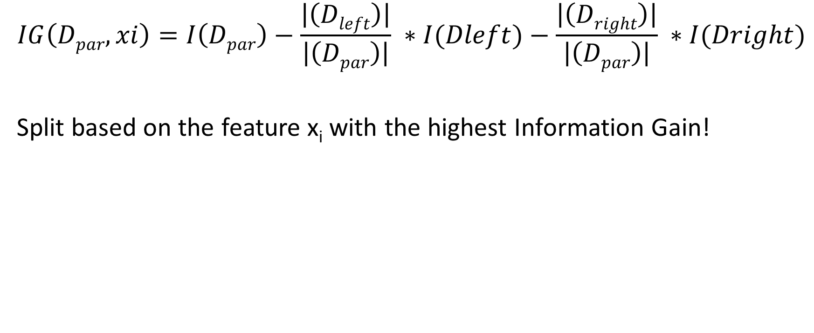
Decision Trees – Choosing a Split
$$IG\left(Dpar,xi\right)=I\left(Dpar\right)−\frac{\left|\left(Dleft\right)\right|}{\left|\left(Dpar\right)\right|} ∗I(Dleft)−\frac{\left|\left(Dright\right)\right|}{\left|\left(Dpar\right)\right|} ∗I(Dright)$$
Split based on the feature x_{i} with the highest Information Gain!

Slide 7
Decision Trees – Splitting Cancer
Compute the IG for a split on each feature, find the maximum
Test A | Test B | Test C | Cancer?
Pos | Neg | Neg | No
Pos | Pos | Neg | No
Neg | Pos | Pos | Yes
Pos | Neg | Pos | Yes

Slide 8
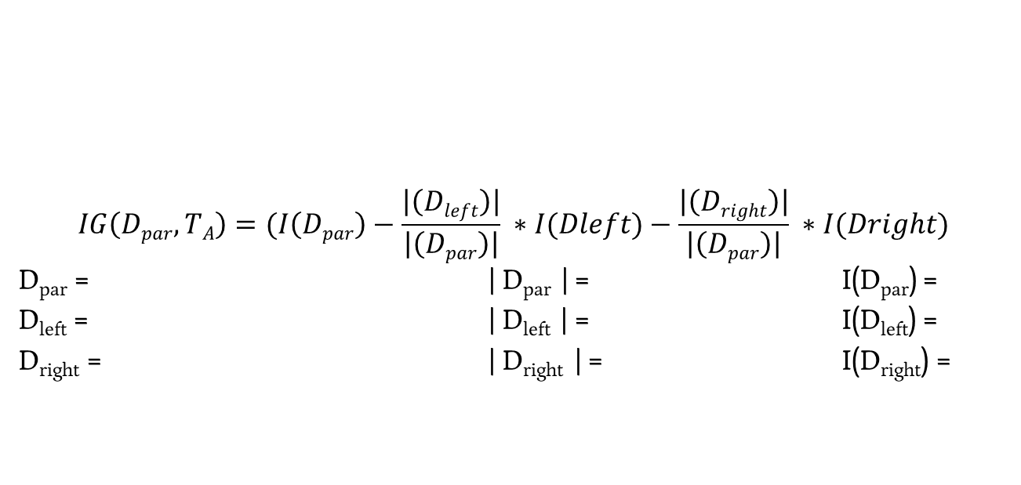
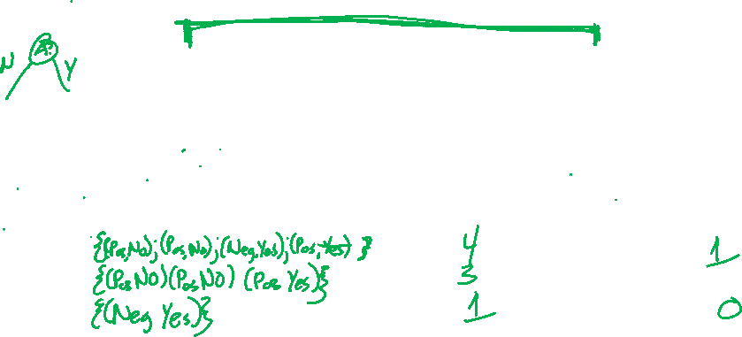
Decision Trees – Splitting Cancer
$$IG\left(Dpar,TA\right)=(I\left(Dpar\right)−\frac{\left|\left(Dleft\right)\right|}{\left|\left(Dpar\right)\right|} ∗I(Dleft)−\frac{\left|\left(Dright\right)\right|}{\left|\left(Dpar\right)\right|} ∗I(Dright)$$
D_{par} = | D_{par} | = I(D_{par}) =
D_{left} = | D_{left} | = I(D_{left}) =
D_{right} = | D_{right} | = I(D_{right}) =
Test A | Test B | Test C | Cancer?
Pos | Neg | Neg | No
Pos | Pos | Neg | No
Neg | Pos | Pos | Yes
Pos | Neg | Pos | Yes

Slide 9
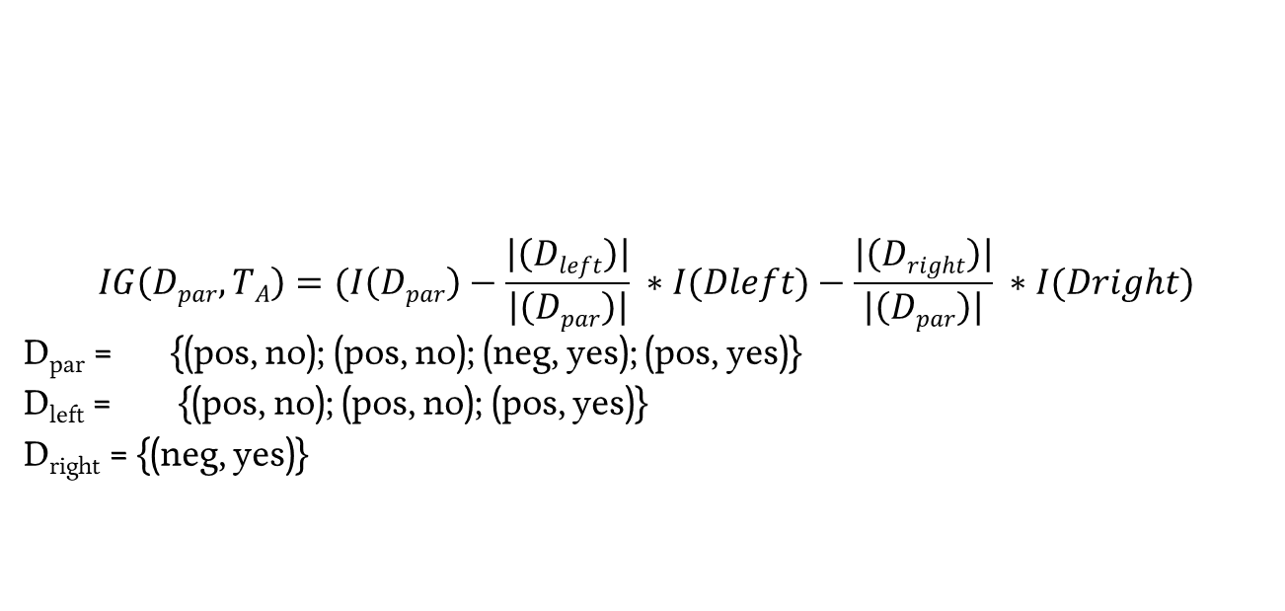
Decision Trees – Splitting Cancer
$$IG\left(Dpar,TA\right)=(I\left(Dpar\right)−\frac{\left|\left(Dleft\right)\right|}{\left|\left(Dpar\right)\right|} ∗I(Dleft)−\frac{\left|\left(Dright\right)\right|}{\left|\left(Dpar\right)\right|} ∗I(Dright)$$
D_{par} = {(pos, no); (pos, no); (neg, yes); (pos, yes)}
D_{left} = {(pos, no); (pos, no); (pos, yes)}
D_{right} = {(neg, yes)}
Test A | Test B | Test C | Cancer?
Pos | Neg | Neg | No
Pos | Pos | Neg | No
Neg | Pos | Pos | Yes
Pos | Neg | Pos | Yes

Slide 10
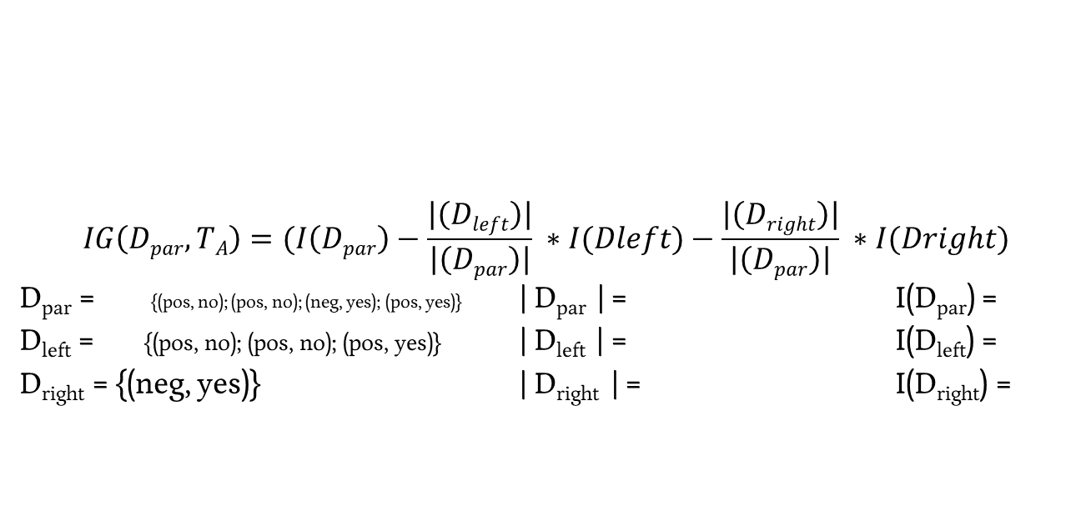
Decision Trees – Splitting Cancer
$$IG\left(Dpar,TA\right)=(I\left(Dpar\right)−\frac{\left|\left(Dleft\right)\right|}{\left|\left(Dpar\right)\right|} ∗I(Dleft)−\frac{\left|\left(Dright\right)\right|}{\left|\left(Dpar\right)\right|} ∗I(Dright)$$
D_{par} = {(pos, no); (pos, no); (neg, yes); (pos, yes)} | D_{par} | = I(D_{par}) =
D_{left} = {(pos, no); (pos, no); (pos, yes)} | D_{left} | = I(D_{left}) =
D_{right} = {(neg, yes)} | D_{right} | = I(D_{right}) =
Test A | Test B | Test C | Cancer?
Pos | Neg | Neg | No
Pos | Pos | Neg | No
Neg | Pos | Pos | Yes
Pos | Neg | Pos | Yes

Slide 11
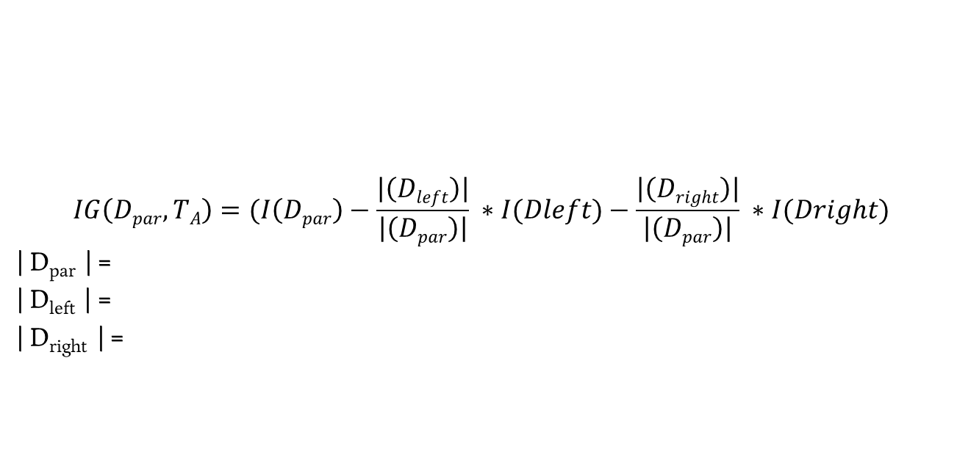
Decision Trees – Splitting Cancer
$$IG\left(Dpar,TA\right)=(I\left(Dpar\right)−\frac{\left|\left(Dleft\right)\right|}{\left|\left(Dpar\right)\right|} ∗I(Dleft)−\frac{\left|\left(Dright\right)\right|}{\left|\left(Dpar\right)\right|} ∗I(Dright)$$
| D_{par} | =
| D_{left} | =
| D_{right} | =
Test A | Test B | Test C | Cancer?
Pos | Neg | Neg | No
Pos | Pos | Neg | No
Neg | Pos | Pos | Yes
Pos | Neg | Pos | Yes

Slide 12
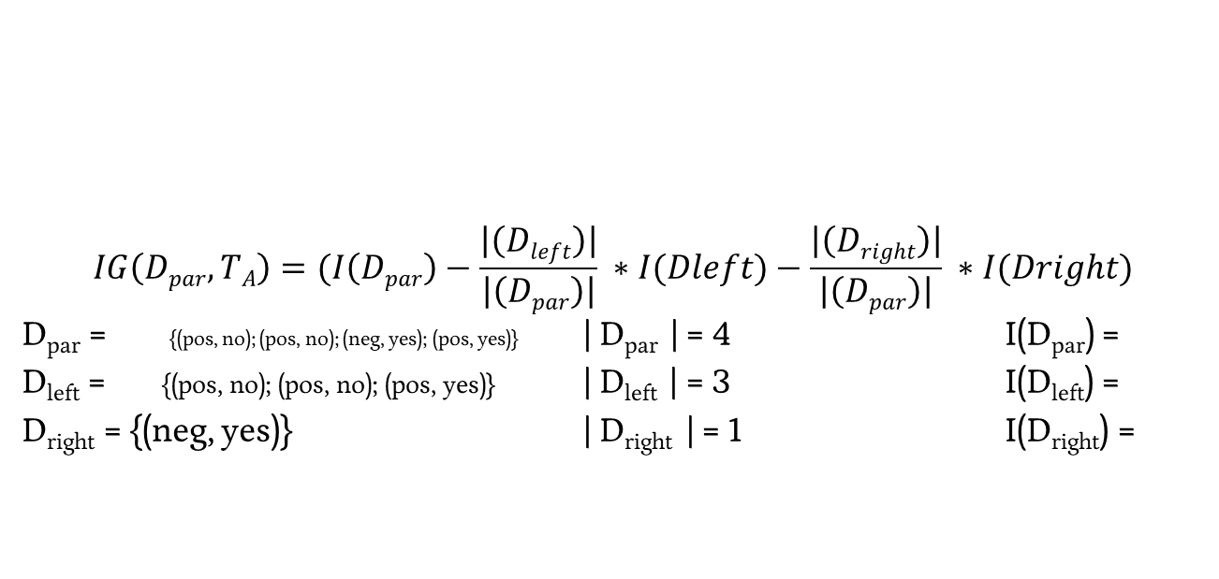
Decision Trees – Splitting Cancer
$$IG\left(Dpar,TA\right)=(I\left(Dpar\right)−\frac{\left|\left(Dleft\right)\right|}{\left|\left(Dpar\right)\right|} ∗I(Dleft)−\frac{\left|\left(Dright\right)\right|}{\left|\left(Dpar\right)\right|} ∗I(Dright)$$
D_{par} = {(pos, no); (pos, no); (neg, yes); (pos, yes)} | D_{par} | = 4 I(D_{par}) =
D_{left} = {(pos, no); (pos, no); (pos, yes)} | D_{left} | = 3 I(D_{left}) =
D_{right} = {(neg, yes)} | D_{right} | = 1 I(D_{right}) =
Test A | Test B | Test C | Cancer?
Pos | Neg | Neg | No
Pos | Pos | Neg | No
Neg | Pos | Pos | Yes
Pos | Neg | Pos | Yes

Slide 13
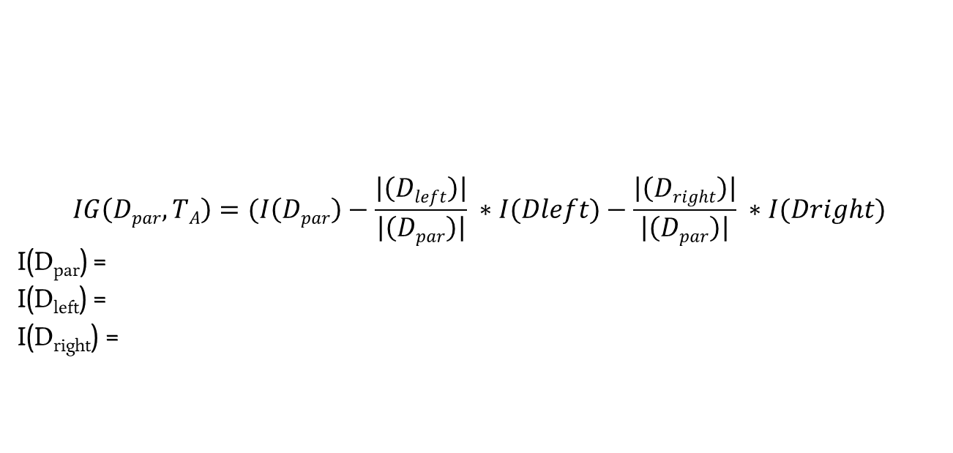
Decision Trees – Splitting Cancer
$$IG\left(Dpar,TA\right)=(I\left(Dpar\right)−\frac{\left|\left(Dleft\right)\right|}{\left|\left(Dpar\right)\right|} ∗I(Dleft)−\frac{\left|\left(Dright\right)\right|}{\left|\left(Dpar\right)\right|} ∗I(Dright)$$
I(D_{par}) =
I(D_{left}) =
I(D_{right}) =
Test A | Test B | Test C | Cancer?
Pos | Neg | Neg | No
Pos | Pos | Neg | No
Neg | Pos | Pos | Yes
Pos | Neg | Pos | Yes

Slide 14
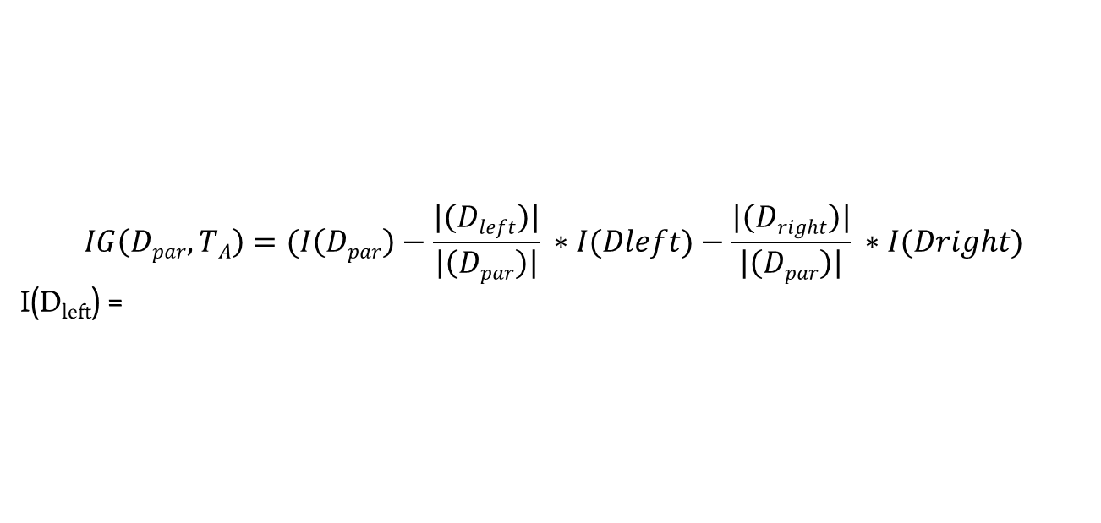
Decision Trees – Splitting Cancer
$$IG\left(Dpar,TA\right)=(I\left(Dpar\right)−\frac{\left|\left(Dleft\right)\right|}{\left|\left(Dpar\right)\right|} ∗I(Dleft)−\frac{\left|\left(Dright\right)\right|}{\left|\left(Dpar\right)\right|} ∗I(Dright)$$
I(D_{left}) =
Test A | Test B | Test C | Cancer?
Pos | Neg | Neg | No
Pos | Pos | Neg | No
Neg | Pos | Pos | Yes
Pos | Neg | Pos | Yes

Slide 15
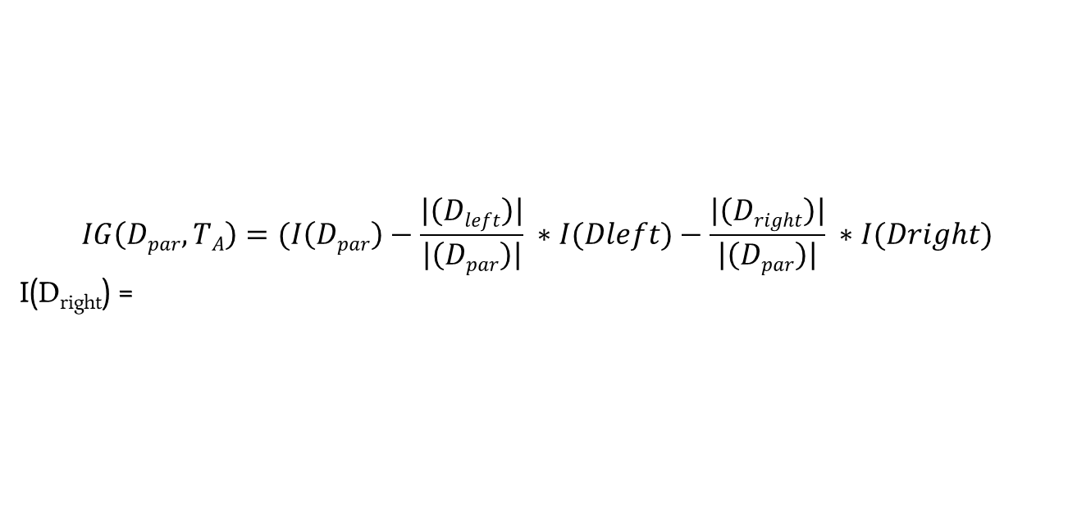
Decision Trees – Splitting Cancer
$$IG\left(Dpar,TA\right)=(I\left(Dpar\right)−\frac{\left|\left(Dleft\right)\right|}{\left|\left(Dpar\right)\right|} ∗I(Dleft)−\frac{\left|\left(Dright\right)\right|}{\left|\left(Dpar\right)\right|} ∗I(Dright)$$
I(D_{right}) =
Test A | Test B | Test C | Cancer?
Pos | Neg | Neg | No
Pos | Pos | Neg | No
Neg | Pos | Pos | Yes
Pos | Neg | Pos | Yes

Slide 16
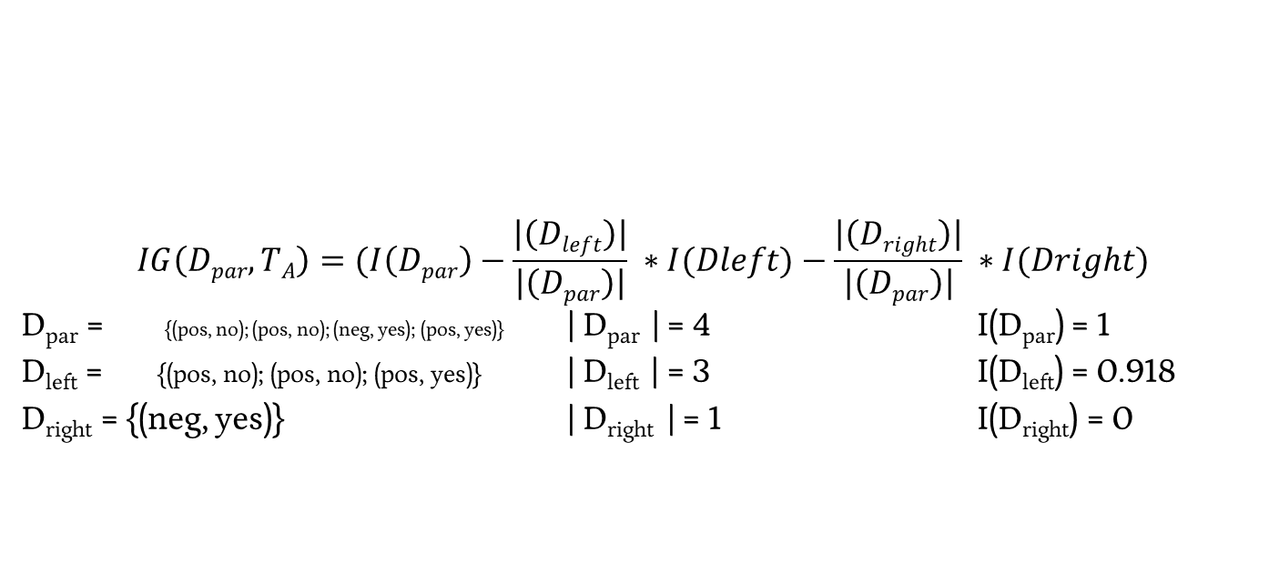
Decision Trees – Splitting Cancer
$$IG\left(Dpar,TA\right)=(I\left(Dpar\right)−\frac{\left|\left(Dleft\right)\right|}{\left|\left(Dpar\right)\right|} ∗I(Dleft)−\frac{\left|\left(Dright\right)\right|}{\left|\left(Dpar\right)\right|} ∗I(Dright)$$
D_{par} = {(pos, no); (pos, no); (neg, yes); (pos, yes)} | D_{par} | = 4 I(D_{par}) = 1
D_{left} = {(pos, no); (pos, no); (pos, yes)} | D_{left} | = 3 I(D_{left}) = 0.918
D_{right} = {(neg, yes)} | D_{right} | = 1 I(D_{right}) = 0
Test A | Test B | Test C | Cancer?
Pos | Neg | Neg | No
Pos | Pos | Neg | No
Neg | Pos | Pos | Yes
Pos | Neg | Pos | Yes

Slide 17
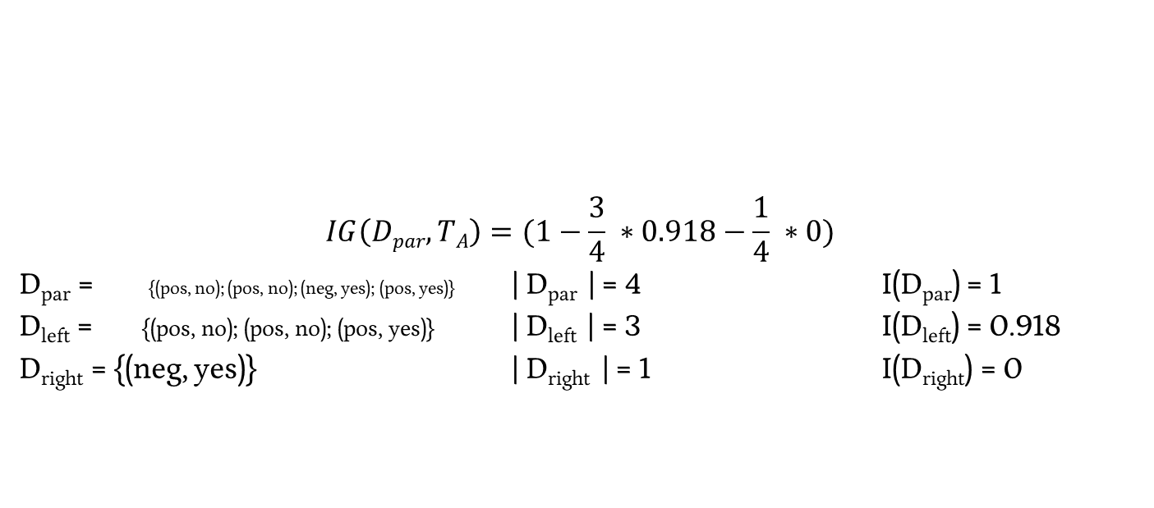

Decision Trees – Splitting Cancer
$$IG\left(Dpar,TA\right)=(1−\frac{3}{4} ∗0.918−\frac{1}{4} ∗0)$$
D_{par} = {(pos, no); (pos, no); (neg, yes); (pos, yes)} | D_{par} | = 4 I(D_{par}) = 1
D_{left} = {(pos, no); (pos, no); (pos, yes)} | D_{left} | = 3 I(D_{left}) = 0.918
D_{right} = {(neg, yes)} | D_{right} | = 1 I(D_{right}) = 0
Test A | Test B | Test C | Cancer?
Pos | Neg | Neg | No
Pos | Pos | Neg | No
Neg | Pos | Pos | Yes
Pos | Neg | Pos | Yes

Slide 18
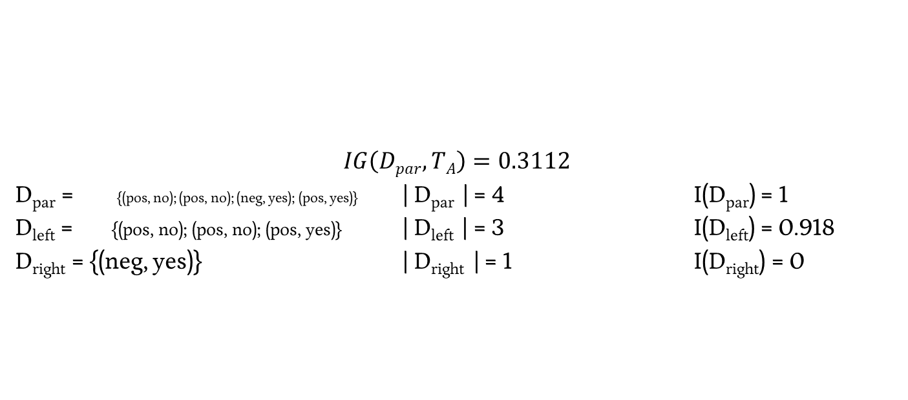
Decision Trees – Splitting Cancer
$$IG\left(Dpar,TA\right)=0.3112$$
D_{par} = {(pos, no); (pos, no); (neg, yes); (pos, yes)} | D_{par} | = 4 I(D_{par}) = 1
D_{left} = {(pos, no); (pos, no); (pos, yes)} | D_{left} | = 3 I(D_{left}) = 0.918
D_{right} = {(neg, yes)} | D_{right} | = 1 I(D_{right}) = 0
Test A | Test B | Test C | Cancer?
Pos | Neg | Neg | No
Pos | Pos | Neg | No
Neg | Pos | Pos | Yes
Pos | Neg | Pos | Yes

Slide 19
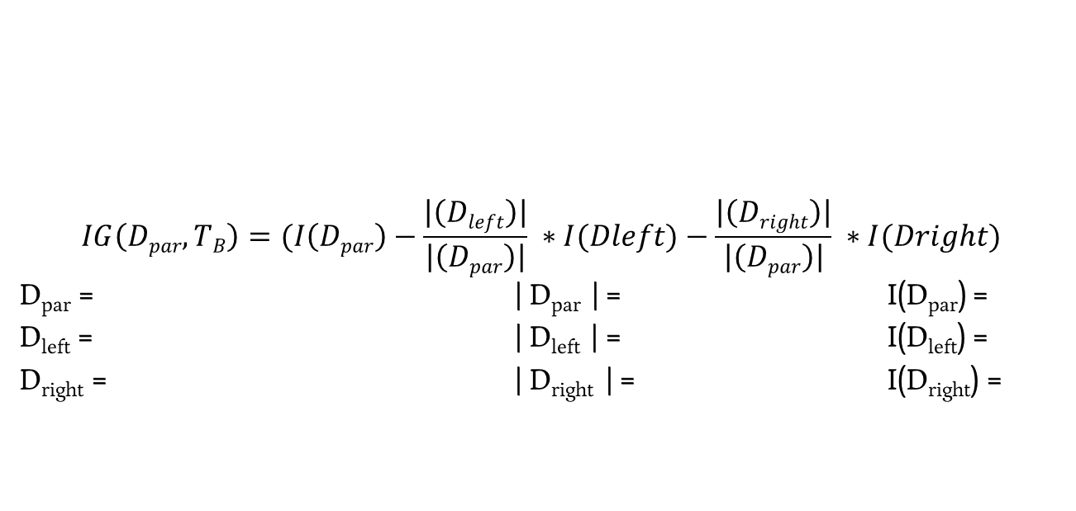
Decision Trees – Splitting Cancer
$$IG\left(Dpar,TB\right)=(I\left(Dpar\right)−\frac{\left|\left(Dleft\right)\right|}{\left|\left(Dpar\right)\right|} ∗I(Dleft)−\frac{\left|\left(Dright\right)\right|}{\left|\left(Dpar\right)\right|} ∗I(Dright)$$
D_{par} = | D_{par} | = I(D_{par}) =
D_{left} = | D_{left} | = I(D_{left}) =
D_{right} = | D_{right} | = I(D_{right}) =
Test A | Test B | Test C | Cancer?
Pos | Neg | Neg | No
Pos | Pos | Neg | No
Neg | Pos | Pos | Yes
Pos | Neg | Pos | Yes

Slide 20
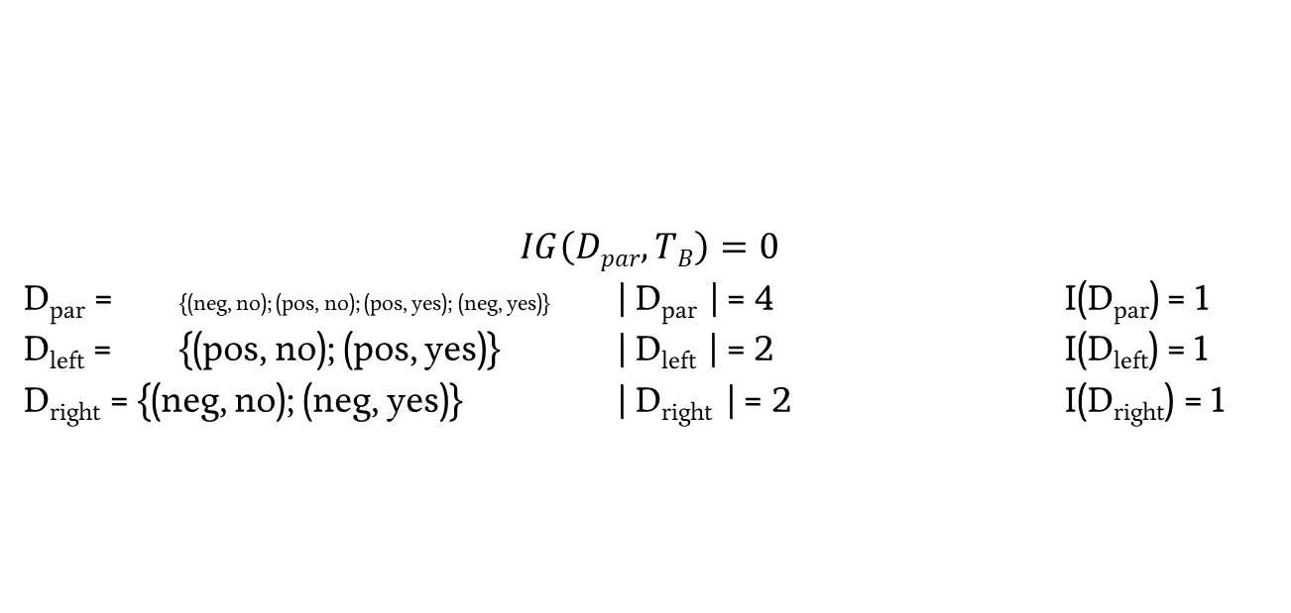
Decision Trees – Splitting Cancer
$$IG\left(Dpar,TB\right)=0$$
D_{par} = {(neg, no); (pos, no); (pos, yes); (neg, yes)} | D_{par} | = 4 I(D_{par}) = 1
D_{left} = {(pos, no); (pos, yes)} | D_{left} | = 2 I(D_{left}) = 1
D_{right} = {(neg, no); (neg, yes)} | D_{right} | = 2 I(D_{right}) = 1
Test A | Test B | Test C | Cancer?
Pos | Neg | Neg | No
Pos | Pos | Neg | No
Neg | Pos | Pos | Yes
Pos | Neg | Pos | Yes

Slide 21
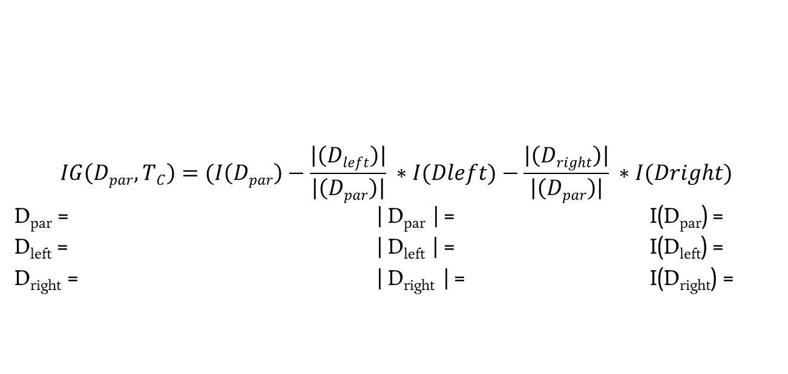
Decision Trees – Splitting Cancer
$$IG\left(Dpar,TC\right)=(I\left(Dpar\right)−\frac{\left|\left(Dleft\right)\right|}{\left|\left(Dpar\right)\right|} ∗I(Dleft)−\frac{\left|\left(Dright\right)\right|}{\left|\left(Dpar\right)\right|} ∗I(Dright)$$
D_{par} = | D_{par} | = I(D_{par}) =
D_{left} = | D_{left} | = I(D_{left}) =
D_{right} = | D_{right} | = I(D_{right}) =
Test A | Test B | Test C | Cancer?
Pos | Neg | Neg | No
Pos | Pos | Neg | No
Neg | Pos | Pos | Yes
Pos | Neg | Pos | Yes

Slide 22
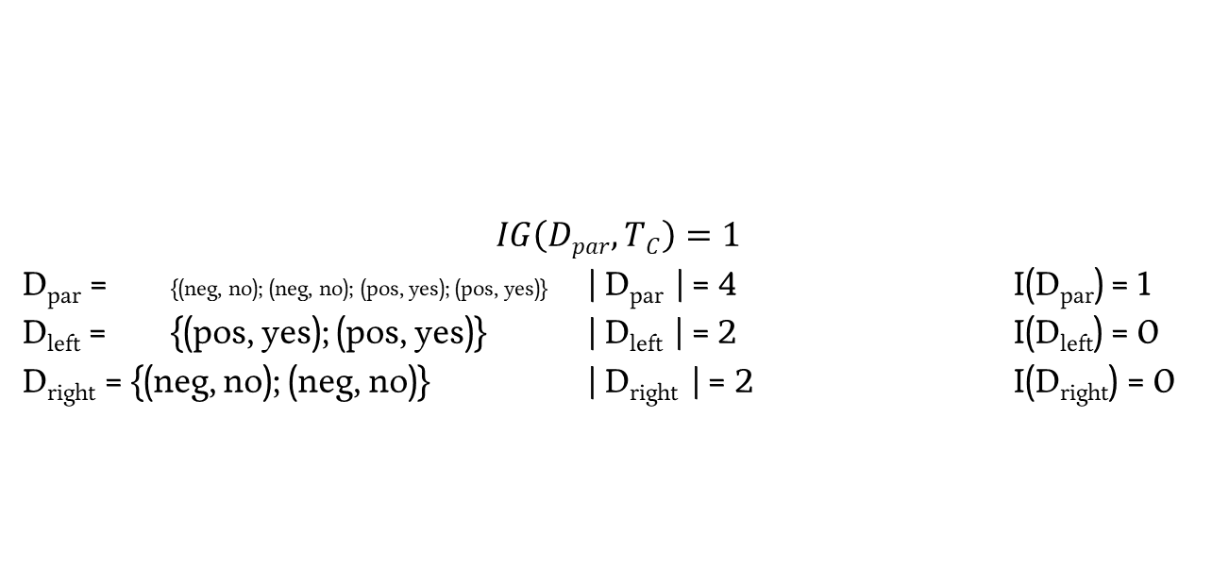
Decision Trees – Splitting Cancer
$$IG\left(Dpar,TC\right)=1$$
D_{par} = {(neg, no); (neg, no); (pos, yes); (pos, yes)} | D_{par} | = 4 I(D_{par}) = 1
D_{left} = {(pos, yes); (pos, yes)} | D_{left} | = 2 I(D_{left}) = 0
D_{right} = {(neg, no); (neg, no)} | D_{right} | = 2 I(D_{right}) = 0
Test A | Test B | Test C | Cancer?
Pos | Neg | Neg | No
Pos | Pos | Neg | No
Neg | Pos | Pos | Yes
Pos | Neg | Pos | Yes

Slide 23
Decision Trees – Measures of Impurity
We used Entropy as the measure of impurity / messiness / chaos
Is this the only option? The correct option?

Slide 24
Decision Trees – Measures of Impurity
We used Entropy as the measure of impurity / messiness / chaos
Is this the only option? The correct option?
Is it sunny in Yuma? 87% yes

Slide 25
Decision Trees – Measures of Impurity
We used Entropy as the measure of impurity / messiness / chaos
Is this the only option? The correct option?
Is it sunny in Yuma? 87% yes
Misclassification Error = min(p, 1-p) = 13%

Slide 26
Decision Trees – Measures of Impurity
We used Entropy as the measure of impurity / messiness / chaos
Is this the only option? The correct option?
Gini Index: 1 - ∑_{c=1…n} p_{c}²
Binary case: 1 – p² – (1 – p)² = 2p(p-1)

Slide 27
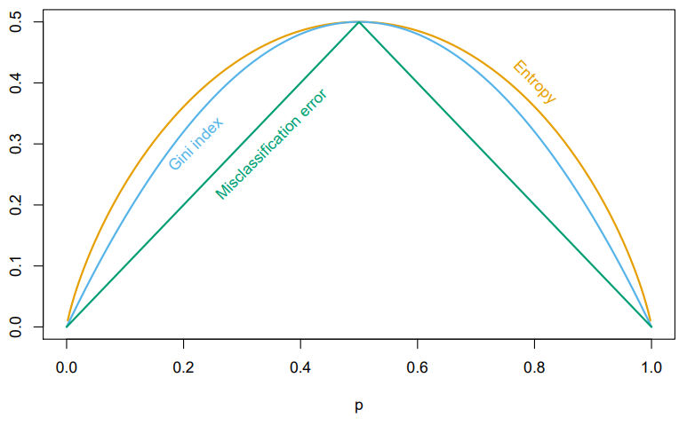
Decision Trees – Measures of Impurity
We used Entropy as the measure of impurity / messiness / chaos
Is this the only option? The correct option?
Considerations: Differentiability, Computational Speed
Different implementations (CART, C4.5) use different functions

Slide 28
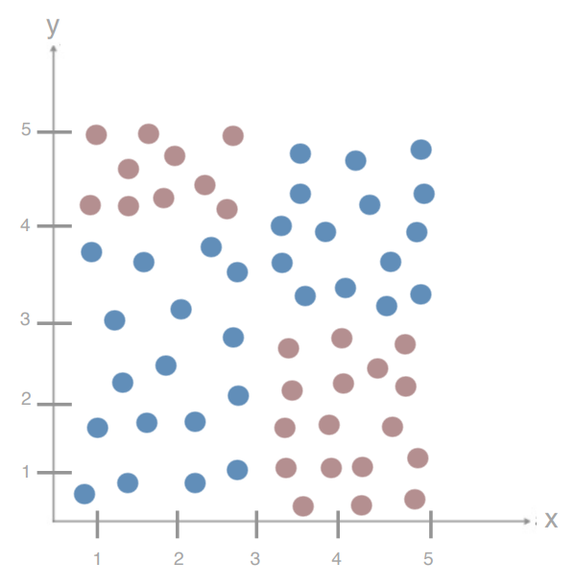
Decision Trees – Adding Complexity
How do we decide the order of our splits?
How do we decide the location of splits?
With continuous variables?
How do we know we’re done?

Slide 29
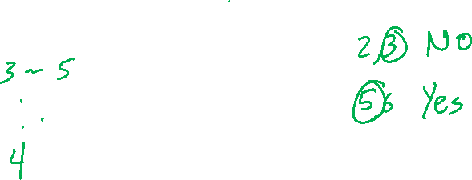
Decision Trees – Continuous Variables
Eyeball – What’s our best splitting point here for Test C?
Test A | Test B | Test C | Cancer?
Pos | Neg | 3 | No
Pos | Pos | 2 | No
Neg | Pos | 6 | Yes
Pos | Neg | 5 | Yes

Slide 30
Decision Trees – Continuous Variables
Eyeball – What’s our best splitting point here for Test C?
How did you do make this decision?
Test A | Test B | Test C | Cancer?
Pos | Neg | 3 | No
Pos | Pos | 2 | No
Neg | Pos | 6 | Yes
Pos | Neg | 5 | Yes

Slide 31
Decision Trees – Continuous Variables
Eyeball – What’s our best splitting point here?
Test A | Test B | Test C | Cancer?
7 | 4 | 3 | No
9 | 8 | 2 | No
2 | 6 | 6 | Yes
8 | 3 | 5 | Yes

Slide 32
Decision Trees – Continuous Variables
Eyeball – What’s our best splitting point here?
Try all options for all variables
IG(D_{par}, x_{i,j})
Test A | Test B | Test C | Cancer?
7 | 4 | 3 | No
9 | 8 | 2 | No
2 | 6 | 6 | Yes
8 | 3 | 5 | Yes

Slide 33
Decision Trees – Continuous Variables
Eyeball – What’s our best splitting point here?
Try all options for all variables
IG(D_{par}, x_{i,j})
Sort first, then compute in one pass
Test A | Test B | Test C | Cancer?
7 | 4 | 3 | No
9 | 8 | 2 | No
2 | 6 | 6 | Yes
8 | 3 | 5 | Yes

Slide 34
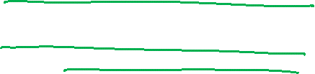
Decision Trees – Adding Complexity
How do we decide the order of our splits?
How do we decide the location of splits?
With continuous variables?
How do we know we’re done?

Slide 35
Decision Trees – Stopping Point
Creating Leaves

Slide 36
Decision Trees – Stopping Point
Creating Leaves
When we reach 0 entropy

Slide 37
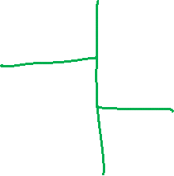
Decision Trees – Stopping Point
Creating Leaves
When we reach 0 entropy

Slide 38
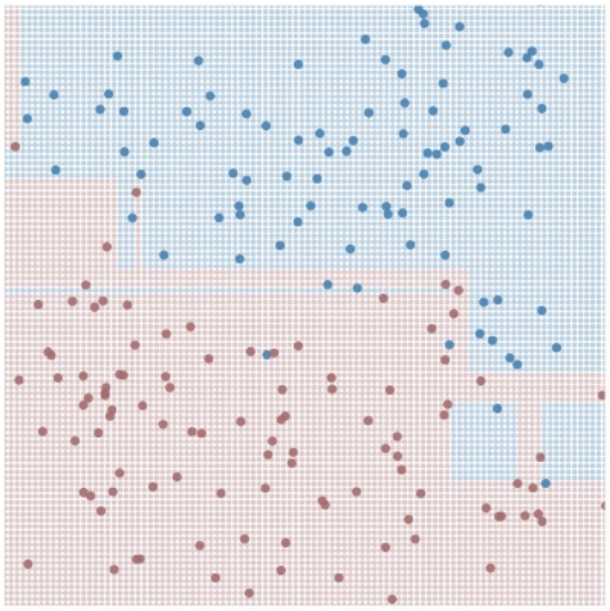
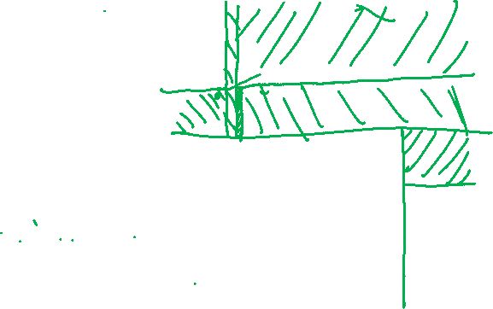
Decision Trees – Stopping Point
Large, Complex Trees

Slide 39
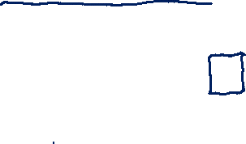
Decision Trees – Stopping Point
Large, Complex Trees
# dimensions spirals out of control
Prone to high variance
Overfitting

Slide 40
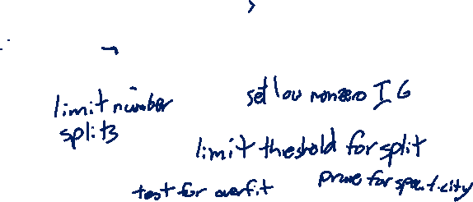
Decision Trees – Stopping Point
Large, Complex Trees
# dimensions spirals out of control
Prone to high variance
Overfitting
What do you want to do about it?

Slide 41

Decision Trees – Limiting Complexity
Set a maximum depth for your tree

Slide 42
Decision Trees – Limiting Complexity
Set a maximum depth for your tree
Set a maximum number of leaves for your tree (proxy on depth, but allows for deep and shallow branches)

Slide 43
Decision Trees – Limiting Complexity
Set a maximum depth for your tree
Set a maximum number of leaves for your tree (proxy on depth, but allows for deep and shallow branches)
Penalize larger trees (more leaves)

Slide 44

Decision Trees – Pruning
Remove segments (subtrees from your tree)
Notes:
https://yourwaytreeserviceinc.com/wp-content/uploads/2014/04/tree-trimming-san-fernando-valley.jpg

Slide 45
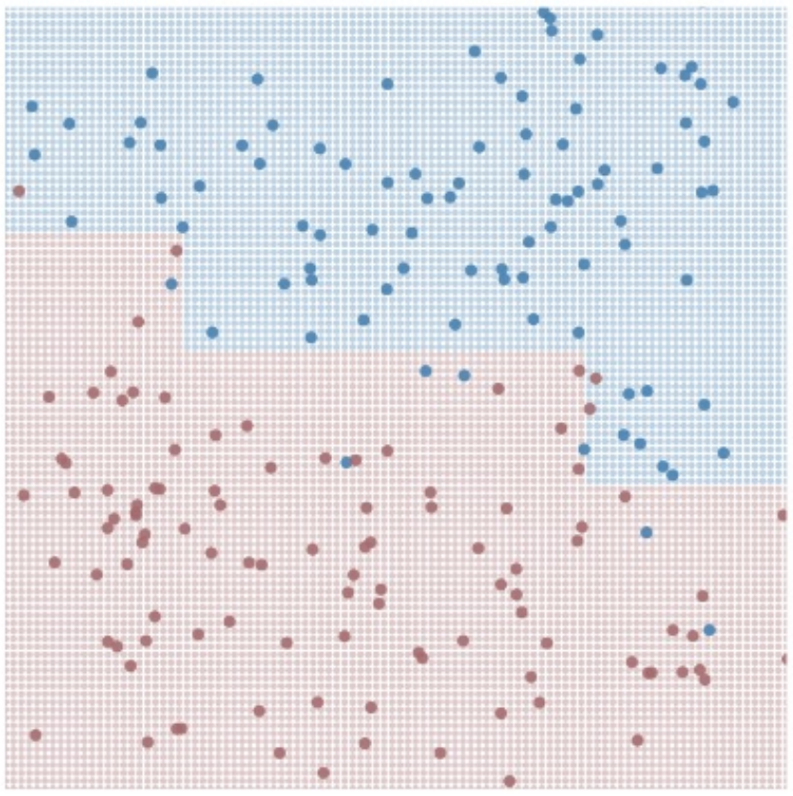
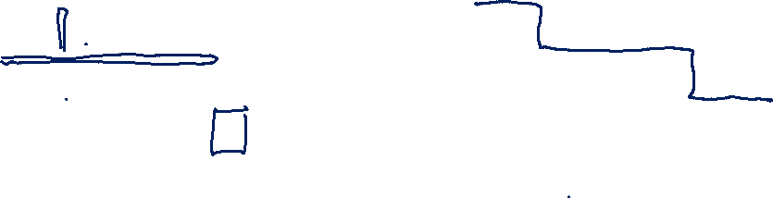
Decision Trees – Pruning
Remove segments (subtrees from your tree)
→

Slide 46
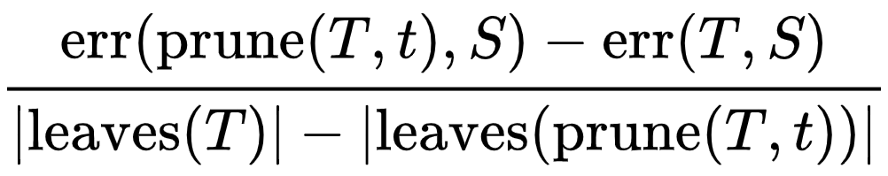
Decision Trees – Limiting Complexity
Penalize larger trees (more leaves)
https://en.wikipedia.org/wiki/Decision_tree_pruning

Slide 47
Ensemble Methods, Boosting, Bagging, & Random Forests

Slide 48
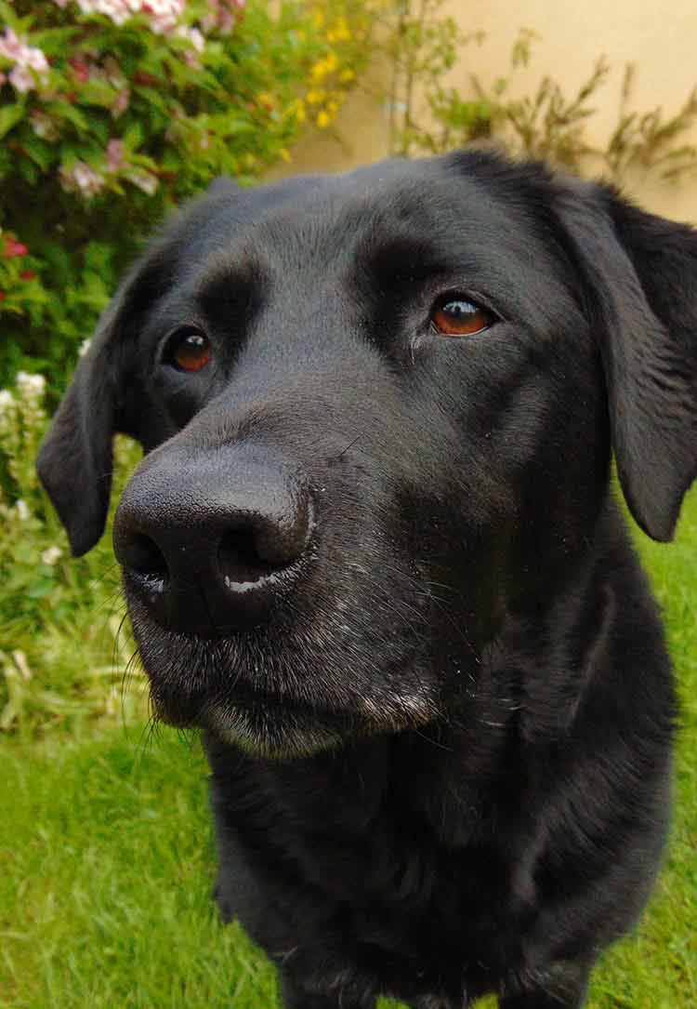
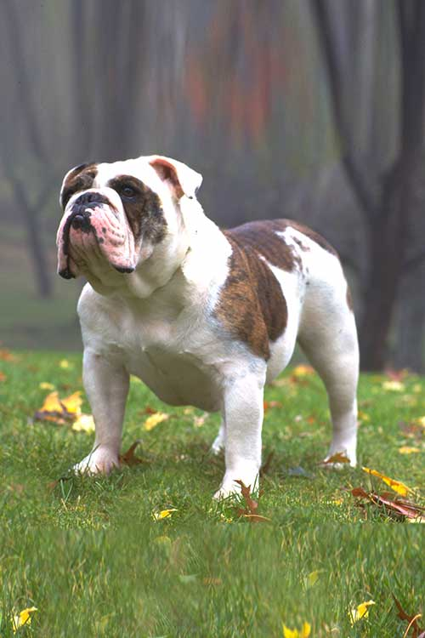
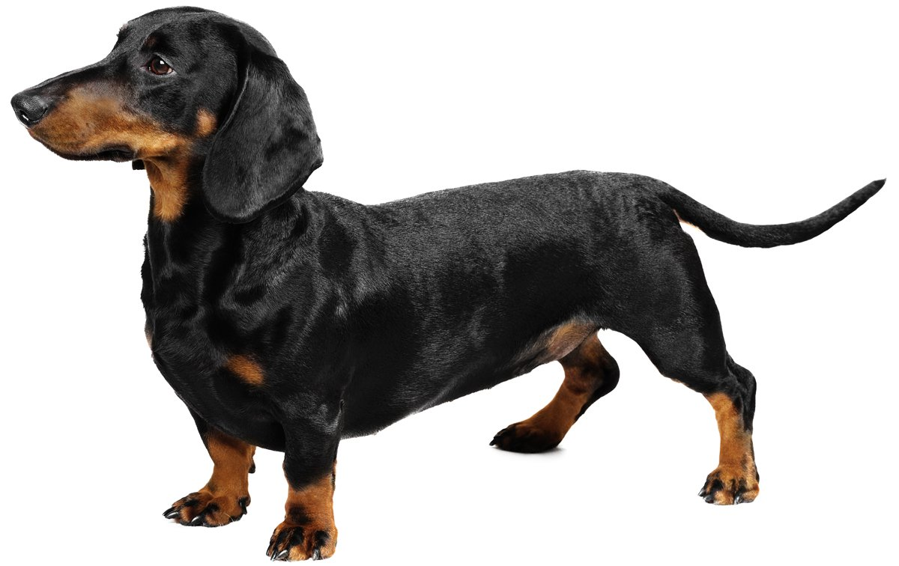
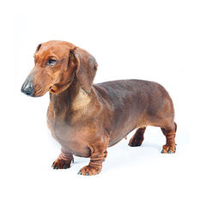
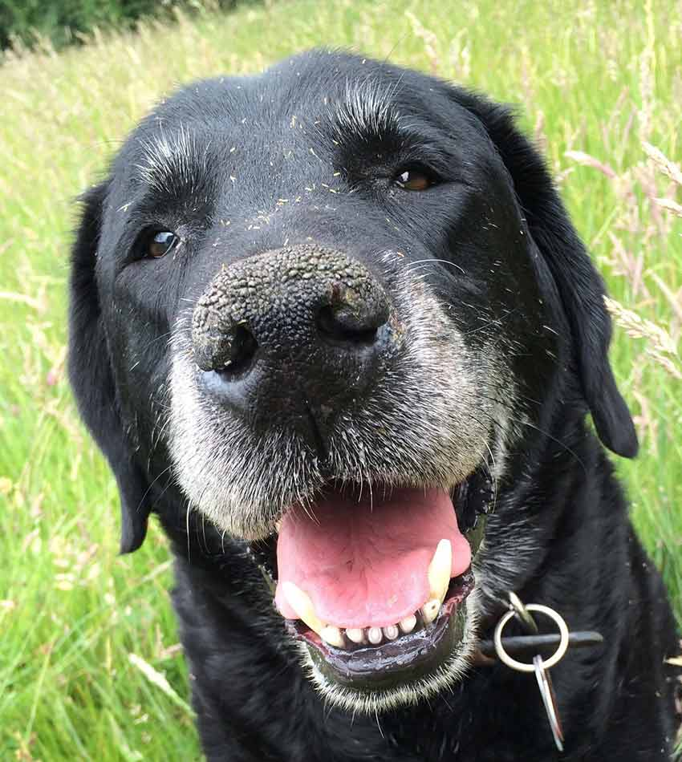
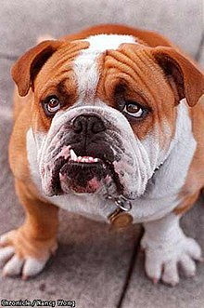

Thinking back…
Multi-class decisions (Week 3)
We built a bunch of different models and relied on consensus
 | vs | vs | vs
 | ? | B | A
 | A | A | ?
 | B | ? | B

Slide 49
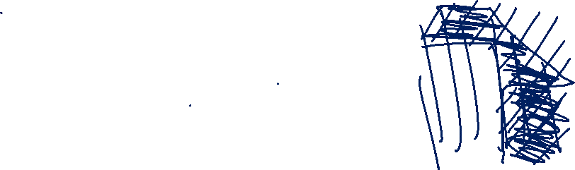
Intuition
Let’s build a few “bad” models

Slide 50
Intuition
Let’s build a few “bad” models
Let’s then combine the predictions!

Slide 51
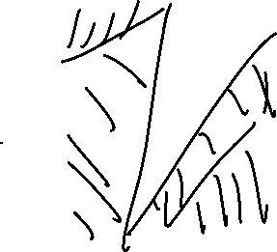
Intuition
Let’s build a few “bad” models
Let’s then combine the predictions!
Let’s add even more “bad” models!

Slide 52
Ensemble Methods
Build a bunch of dumb models on the training data
There are a bunch of ways to do this, stay tuned!
Feed our test data to all the models, get predictions
Take the best class from all of these models as our answer

Slide 53
Ensemble Learning – Dataset
X₁ | X₂ | X₃ | X₄ | X₅ | Y
Size (Sq. Ft.) | # Bed | # Bath | Year Built | Price ($) | Single Family?
1200 | 1 | 1.5 | 1998 | 200,000 | No
1800 | 2 | 2 | 1985 | 450,000 | Yes
800 | 1 | 1 | 2017 | 250,000 | No
2500 | 3 | 2 | 1975 | 500,000 | No
2800 | 4 | 2.5 | 1983 | 400,000 | Yes
… | … | … | … | …

Slide 54
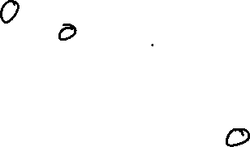
Building “Dumb” Models – Step 1
Maybe 10% of the points in training
are causing errors with testing…

Slide 55
Building “Dumb” Models – Step 1
Maybe 10% of the points in training
are causing errors with testing…

Slide 56
Building “Dumb” Models – Step 1
Maybe 10% of the points in training
are causing errors with testing…
What happens if I build a tree based on
a resampling of my points?

Slide 57
Building “Dumb” Models – Resampling
Pick N’ (number in subsample) points
Train model on subsample

Slide 58
Building “Dumb” Models – Resampling
Pick N’ points
Train model on subsample

Slide 59
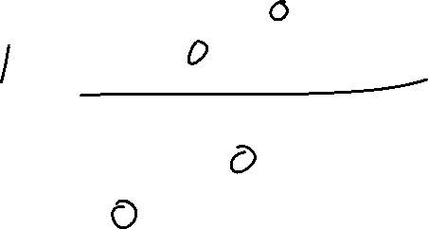
Building “Dumb” Models – Step 1
Maybe 10% of the points in training
are causing errors with testing…
What happens if I build a tree based on
10% of the points?

Slide 60
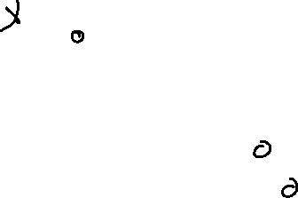
Building “Dumb” Models – Step 1
Maybe 10% of the points in training
are causing errors with testing…
What happens if I build a tree based on
10% of the points?
What happens if I build a tree based on
90% of the points?

Slide 61
Building “Dumb” Models – Resampling
Small Subsets
- Prone to high bias (underfitting)

Slide 62
Building “Dumb” Models – Resampling
Small Subsets
- Prone to high bias (underfitting)
Large Subsets
- Prone to behave exactly like our dataset

Slide 63
Building “Dumb” Models – Bootstrapping
Large Subsets with replacement
- We will oversample some points, neglect others

Slide 64
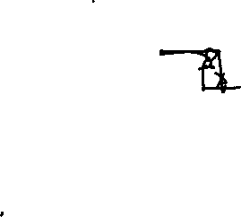
Building “Dumb” Models – Bootstrapping
Large Subsets with replacement
- We will oversample some points, neglect others
Sampling N’ = N
- Expected 1 – 1/e (approx. 63.2%) coverage
https://en.wikipedia.org/wiki/Bootstrap_aggregating

Slide 65
Building “Dumb” Models – Bootstrapping
Large Subsets with replacement
- We will oversample some points, neglect others
Sampling N’ = N
- Expected 1 – 1/e (approx. 63.2%) coverage
N is too large for my memory
- Reduce N’ – but realize the bias-variance tradeoff
https://en.wikipedia.org/wiki/Bootstrap_aggregating

Slide 66
Building “Dumb” Models – Step 2
Maybe 10% of the points in training
are causing errors with testing…
What happens if I build a tree based on a resampling of the points?

Slide 67
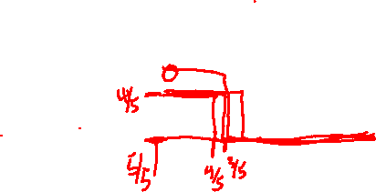
Building “Dumb” Models – Step 2
Maybe 10% of the points in training
are causing errors with testing…
What happens if I build a tree based on a resampling of the points?
What happens if I build a bunch of trees based on a resampling of the points?

Slide 68
Building “Dumb” Models – Bagging (Bootstrap Aggregating
TRAINING
For M (# Models) iterations:
Select N points with replacement
Train a decision tree
Hang on to that decision tree
TESTING
For each test point:
Ask all the decision trees what decision to make
Accept Y (the best answer)

Slide 69
Building “Dumb” Models – Bagging
TRAINING
For M iterations:
Select N points with replacement
Train a decision tree
Hang on to that decision tree
TESTING
For each test point:
Ask all the decision trees what decision to make
Accept Y

Slide 70
Ensemble Learning
Build a group of models H(x) = h₁(x), h₂(x), … h_{k}(x)

Slide 71
Building “Dumb” Models – Bagging
TRAINING
For K iterations:
Select N points with replacement
Train a decision tree
Hang on to that decision tree
TESTING
For each test point:
Ask all the decision trees what decision to make
Accept Y

Slide 72
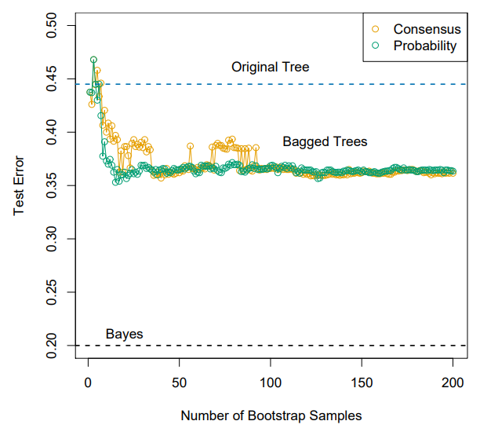
Bagging – Appropriate number of models
In short – it depends
- Think of this as a stopping parameter
- You’ll see numbers like 30, 50, 100 used a lot…

Slide 73

Bagging – Choosing Consensus
Binary decision from each tree
Take the majority decision

Slide 74
Thursday

Slide 75


Slide 76
Course Logistics
Project: Groups due now!
As in about a couple minutes ago
If you didn’t submit, go do it right this instant. Watch lecture later.
Project 2: Pitch and Project 2.1: Pitch Feedback instructions are now viewable on Canvas
Problem Sets: Problem Set 1 Due 9/15

Slide 77
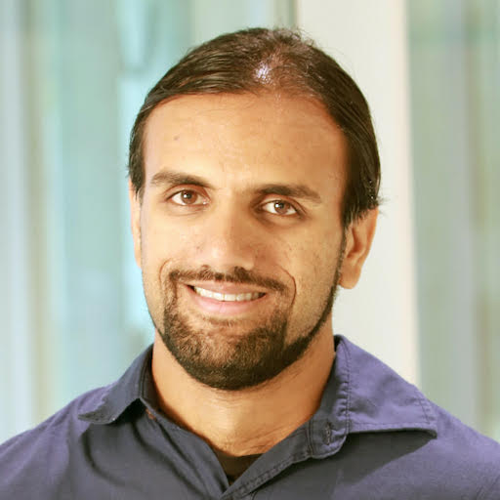

Guest Speaker Tuesday
Nikhil Krishnaswamy – CSU
Works at the intersection of Human Computer Communication (NLP, etc.) and HCI problems
Part of the Institute for Human-AI Teaming
An national NSF Funded Institute housed here at CU

Slide 78
Building “Dumb” Models – Bagging
TRAINING
For K iterations:
Select N points with replacement
Train a decision tree
Hang on to that decision tree
TESTING
For each test point:
Ask all the decision trees what decision to make
Accept Y

Slide 79
Bagging – Appropriate number of models
In short – it depends
- Think of this as a stopping parameter
- You’ll see numbers like 30, 50, 100 used a lot…

Slide 80
Bagging – Choosing Consensus
Binary decision from each tree
Take the majority decision

Slide 81
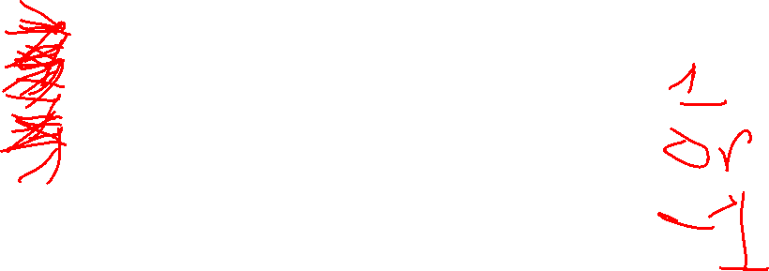
Ensemble Learning – Example (walkthrough)
X₁ | X₂ | X₃ | X₄ | X₅ | Y
Size (Sq. Ft.) | # Bed | # Bath | Year Built | Price ($) | Single Family?
1200 | 1 | 1.5 | 1998 | 200,000 | No
1800 | 2 | 2 | 1985 | 450,000 | Yes
800 | 1 | 1 | 2017 | 250,000 | No
2500 | 3 | 2 | 1975 | 500,000 | No
2800 | 4 | 2.5 | 1983 | 400,000 | Yes
… | … | … | … | …

Slide 82
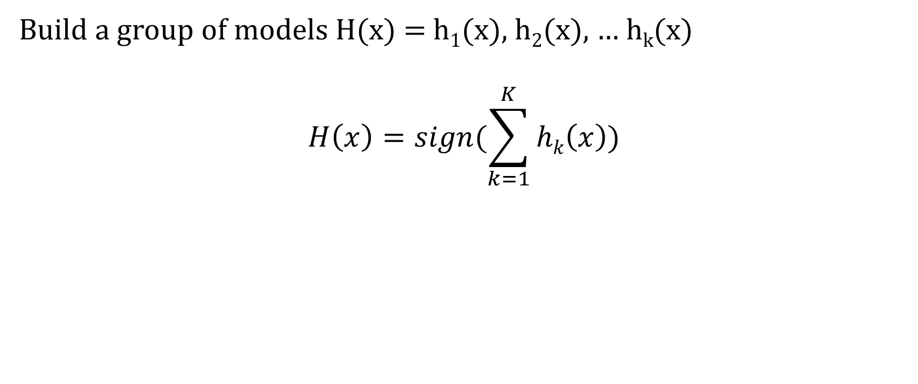
Ensemble Learning
Build a group of models H(x) = h₁(x), h₂(x), … h_{k}(x)
$$H\left(x\right)=sign(\sum_{k=1}^{K}{hk\left(x\right)})$$

Slide 83
Bagging - Benefits

Slide 84
Bagging - Benefits
Reducing the variance (overfitting)?

Slide 85
Bagging - Benefits
Reducing the variance (overfitting)
Variance – Sensitivity to the training set
Yes

Slide 86
Bagging - Benefits
Reducing the variance (overfitting)
Variance – Sensitivity to the training set
Yes
Reducing the bias (underfitting)?

Slide 87
Bagging - Benefits
Reducing the variance (overfitting)
Variance – Sensitivity to the training set
Yes
Reducing the bias (underfitting)
Bias – Sensitivity to the model
No

Slide 88
Ensemble Learning - Improvements
We have aggregated models helping reduce the variance, but how can we reduce the bias?
Bias – Sensitivity to the model

Slide 89


Ensemble Learning - Improvements
We have aggregated models helping reduce the variance, but how can we reduce the bias?
Bias – Sensitivity to the model
Looking at some example trees…

Slide 90
Ensemble Learning – Reducing Bias
The trees are demonstrating high correlation
- Many of our trees are using an identical splitting point for the first decision!
- This correlation is a source of bias
We need to force the trees to care about different features

Slide 91

Ensemble Learning – Feature Subsets
Within the bagging loop, force each split to be made based on a subset of features
X₁ | X₂ | X₃ | X₄ | X₅ | Y
Size (Sq. Ft.) | # Bed | # Bath | Year Built | Price ($) | Single Family?
1200 | 1 | 1.5 | 1998 | 200,000 | No
1800 | 2 | 2 | 1985 | 450,000 | Yes
800 | 1 | 1 | 2017 | 250,000 | No
2500 | 3 | 2 | 1975 | 500,000 | No
2800 | 4 | 2.5 | 1983 | 400,000 | Yes
… | … | … | … | …

Slide 92
Ensemble Methods– Random Forests
TRAINING
For M iterations:
Select N’ points with replacement
Train a decision tree:
For each split:
Choose F features to split on:
Choose your best split from them
Hang on to that decision tree
TESTING
For each test point:
Ask all the decision trees what decision to make
Accept Y

Slide 93

Random Forests – Choosing # Features (F)
In short – it depends!
- Treat this as a tuning parameter
- Similar to K in KNN, λ in Ridge / Lasso Regression
Sqrt(|X|) is a good
default
X₁ | X₂ | X₃ | X₄ | X₅ | Y
Size (Sq. Ft.) | # Bed | # Bath | Year Built | Price ($) | Single Family?
1200 | 1 | 1.5 | 1998 | 200,000 | No
1800 | 2 | 2 | 1985 | 450,000 | Yes
800 | 1 | 1 | 2017 | 250,000 | No
2500 | 3 | 2 | 1975 | 500,000 | No
2800 | 4 | 2.5 | 1983 | 400,000 | Yes
… | … | … | … | …

Slide 94
Ensemble Methods
We’re building all of these ideas on “Dumb” models, but surely we can do better?
The goodness comes out through aggregation, but some models may be “better” than others
- Can we try to trust these models more?

Slide 95
Boosting

Slide 96
Interlude – A Weak Learner
Assumptions – binary classification problem
both classes are 50% likely
Expectations

Slide 97

Ensemble Methods – A Weak Learner
Assumptions - binary classification problem
both classes are 50% likely
Expectations - A random guess model gets 50% accuracy
$$err=\frac{1}{n}∗∑i1…N I(yi ≠G\left(xi\right))$$

Slide 98
Ensemble Methods – A Weak Learner
Assumptions - binary classification problem
both classes are 50% likely
Expectations - A random guess model gets 50% accuracy
A “weak” learning model would perform slightly better than chance
We can only determine this through training accuracy / error

Slide 99

Weak Learner – Decision Stump
A 1-layer decision tree (a.k.a. a decision tree with a single split)
Entropy = -p * log₂(p) – (1-p) * log₂(1-p)
Notes:
https://en.wikipedia.org/wiki/File:Decision_stump.svg

Slide 100
Weak Learner – Decision Stump
A 1-layer decision tree (a.k.a. a decision tree with a single split)
Entropy = -p * log₂(p) – (1-p) * log₂(1-p)
This could serve as a restriction on # dimensions, tree size for random forest!
Notes:
https://en.wikipedia.org/wiki/File:Decision_stump.svg

Slide 101
Ensemble Methods - Boosting
All animals are equal, but some animals are more equal than others.
- George Orwell (Animal Farm, Chapter 10)

Slide 102
Ensemble Methods - Boosting
All animals are equal, but some animals are more equal than others.
- George Orwell (Animal Farm, Chapter 10)
All classifiers are equal, but some classifiers are more equal than others.
In an ensemble classifier, can we favor some of the individual classifiers more than others?

Slide 103

Boosting – Favoring Certain Points
Create a bunch of classifiers
Weight each model k based on how accurate it is
$$H\left(x\right)=sign(\sum_{k=1}^{K}{hk\left(x\right)})$$
becomes
$$H\left(x\right)=sign(\sum_{k=1}^{K}{\text{α}khk\left(x\right)})$$

Slide 104

Weights for Individual Classifiers

Slide 105

Weights for Individual Classifiers

Slide 106

Weights for Individual Classifiers
$$err= \sum_{i=1}^{m}{I(yi ≠h\left(xi\right))}$$

Slide 107

Weights for Individual Classifiers
$$err= \sum_{i=1}^{m}{I(yi ≠h\left(xi\right))}$$
Err = 3
Error range = [0, ∞]

Slide 108

Weights for Individual Classifiers
$$err= \frac{\sum_{i=1}^{m}{I(yi ≠h\left(xi\right))}}{m}$$
Err = 0.3
Error range = [0, 1]

Slide 109

Weights for Individual Classifiers
Option 1: Linear weight based on error
$$\text{α}k=1 −err$$

Slide 110

Weights for Individual Classifiers
Option 1: Linear weight based on error
$$\text{α}k=1 −err$$
A 10% accuracy model (i.e. incorrect class 9 out of 10 times)
$\text{α}k$ = .1

Slide 111

Weights for Individual Classifiers
Option 1: Linear weight based on error
$$\text{α}k=1 −err$$
A 10% accuracy model (i.e. incorrect class 9 out of 10 times)
$\text{α}k$ = .1
Need a weight function that does better…

Slide 112


Exponential Weights for Individual Classifiers
$$\text{α}k=\frac{1}{2}log⁡(\frac{1−errk}{errk})$$
Grows for low error
Approaches 0 for error .5 (chance)
Negative penalty for high error

Slide 113

Weights for Individual Classifiers
$$err= \frac{\sum_{i=1}^{m}{I(yi ≠h\left(xi\right))}}{m}$$
Err = 0.3
$$\text{α}k=\frac{1}{2}log⁡(\frac{1−{err}_{k}}{errk})$$

Slide 114

Weights for Individual Classifiers
$$err= \frac{\sum_{i=1}^{m}{I(yi ≠h\left(xi\right))}}{m}$$
Err = 0.3
$$\text{α}k=\frac{1}{2}log⁡(\frac{1−{err}_{k}}{errk})$$
$\text{α}k$ = 0.42

Slide 115

Weights for Individual Classifiers
Could we have done a better split on this model than 70% accuracy (30% error)?

Slide 116
Weights for Individual Classifiers
What’s going to happen when we create 30, 50, 100 classifiers here?

Slide 117
Weights for Individual Classifiers
What’s going to happen when we create 30, 50, 100 classifiers here?
Entropy will always look the same for new models!
Even if we use a random forest, we have 2 dimensions!

Slide 118
Ensemble Methods - Boosting
All animals are equal, but some animals are more equal than others.
- George Orwell (Animal Farm, Chapter 10)

Slide 119
Ensemble Methods - Boosting
All animals are equal, but some animals are more equal than others.
- George Orwell (Animal Farm, Chapter 10)
All points are equal, but some points are more equal than others.
Can we favor points that are proving difficult to accurately classify?

Slide 120

Boosting – Favoring Certain Points
Iteratively create a bunch of classifiers
Weight each model k based on how accurate it is
$$H\left(x\right)=sign(\sum_{k=1}^{K}{\text{α}khk\left(x\right)})$$
Weight each point based on how well it was classified for h_{k}(x)
If we classified it correctly, it was easy, lower the weight
If we classified incorrectly, it was hard, raise the weight

Slide 121


Boosting – Favoring certain Points

Slide 122


Boosting – Favoring certain Points

Slide 123

Initializing our Weights
Assume all points are equal
$$wi=1/n$$

Slide 124
Updating our Weights
Up weight for incorrect
Down weight for correct
Based on accuracy of the model

Slide 125

Updating our Weights - Adaboost
Up weight for incorrect
Down weight for correct
Based on accuracy of the model
$$wi=\frac{wi}{Zk}∗exp⁡(−\text{α}\text{k}\text{y}\text{i}\text{h}\text{k}\text{(}\text{xi}\text{))}$$
*Z_{k} is a normalization factor – we can just normalize afterwards instead
$$\sum_{i=1}^{n}{wi}=1$$

Slide 126

Adaboost in practice
TRAINING
Initialize weights
For k = 1 → K
Fit Classifier
Compute error
Compute weight for classifier k
Update weights
TESTING
For test point
Output $H\left(x\right)=sign(\sum_{k=1}^{K}{\text{α}khk\left(x\right)})$

Slide 127

Fitting Classifier
Entropy = -p * log₂(p) – (1-p) * log₂(1-p)
p = fraction of positive points
p = $\frac{\sum_{i=1}^{n}{I(yi=1)}}{n}$

Slide 128

Fitting Classifier
Entropy = -p * log₂(p) – (1-p) * log₂(1-p)
p = fraction of positive points
p = $\frac{\sum_{i=1}^{n}{I(yi=1)}}{n}$
p = weighted fraction of positive points
p = $\frac{\sum_{i=1}^{n}{wiI(yi=1)}}{n\sum_{i=1}^{n}{wi}}$

Slide 129

Weights for Individual Classifiers
$$err= \frac{\sum_{i=1}^{m}{I(yi ≠h\left(xi\right))}}{m}$$

Slide 130

Weights for Individual Classifiers
$$err= \frac{\sum_{i=1}^{m}{I(yi ≠h\left(xi\right))}}{m}$$
$$err= \frac{\sum_{i=1}^{m}{wiI(yi ≠h\left(xi\right))}}{\sum_{i=1}^{m}{wi}}$$

Slide 131
Adaboost in practice
TRAINING
Initialize weights
For k = 1 → K
Fit Classifier
Compute error
Compute weight for classifier k
Update weights
TESTING
For test point
Output $H\left(x\right)=sign(\sum_{k=1}^{K}{\text{α}khk\left(x\right)})$

Slide 132


Adaboost – Working Example
First Decision Stump

Slide 133


Adaboost – Working Example
First Decision Stump

Slide 134


Adaboost – Working Example
First Decision Stump

Slide 135


Adaboost – Working Example
Second Decision Stump

Slide 136


Adaboost – Working Example
Second Decision Stump

Slide 137


Adaboost – Working Example
Second Decision Stump

Slide 138


Adaboost – Working Example
Third Decision Stump

Slide 139


Adaboost – Working Example
Third Decision Stump

Slide 140


Adaboost – Working Example
Final Ensemble Model

Slide 141
Boosting - Benefits
Reducing the variance?
Variance – Sensitivity to the training set
Reducing the bias?
Bias – Sensitivity to the model

Slide 142
Boosting - Benefits
Reducing the variance
Variance – Sensitivity to the training set
Yes
Reducing the bias
Bias – Sensitivity to the model
Yes

Slide 143


Model Performance
Traditional Models
Boosted Models

Slide 144
Benefits of Boosting
Fast
Easy to Train
Little tuning (K)
Weak-classifier Independent

Slide 145

Boosting “gotchas”
Data-dependent
Weak-learner-dependent
- Can overfit with too strong of a learner
$\text{α}$ can grow too large
- Can underfit with too weak of a learner

Slide 146

Comparison Activity

Slide 147
Deciding More Complex Things

Slide 148
Binary Classification
Classified As Ground Truth | Cancer | Not Cancer
Cancer | True Positive (Hit) | False Negative (Miss)
Not Cancer | False Positive (False Alarm) | True Negative (Correct Rejection)

Slide 149

Multi-Class Example
Notes:
https://upload.wikimedia.org/wikipedia/commons/d/d9/Collage_of_Nine_Dogs.jpg

Slide 150
Multi-Class Example - Dogs
Height | Weight | Color | Dog Type
22 in | 62 lbs | Black | Black Lab
15 in | 45 lbs | White, brown | English Bulldog
9 in | 19 lbs | Black | Dachshund

Slide 151
Classification → Binary Classification
Is this tweet positive Is this tweet positive or not positive?
or negative?
Y = {pos, neg} Y = {1, 0}
y = argmax_{c} p(c|x, D) p(y=0 | x, D) = 1 – p(y=1 | x, D)

Slide 152

Classification vs. Binary Classification
Y = {1, 2, 3, …, n} Y = {1, 0}
y = argmax_{c} p(c|x, D) p(y=0 | x, D) = 1 – p(y=1 | x, D)
Determining the decade Positive or not positive tweets
of birth
Species of tree Is the road clear of obstructions?
Type of road sign

Slide 153
Classification vs. Binary Classification
Some methods are inherently capable of multi-class classification
Naïve Bayes - y = argmax_{c} p(c|x, D)
KNN – find N_{k}(x, D), assign the majority (plurality) label to x

Slide 154

Multi-Class Classification - KNN
Notes:
https://www.cs.ubc.ca/~schmidtm/Software/matLearn/multiclass/demos/html/demo_multiclass_KNN_01.png

Slide 155


Multi-Class Classification – Decision Trees

Slide 156
Interlude – Types of Data
Continuous Numeric
- Maps to a “real” number
- Distances between numbers have meaning
Discrete Numeric
- Maps to a discrete, infinite set (e.g. integers)
- Distances between numbers have meaning
Ordinal
- Entries have an order, but distances lose meaning
Categorical
- Entries are each unique, but don’t have further restrictions

Slide 157
“Classify” a Numeric Problem?
…

Slide 158
It’s not Classification, it’s Regression!

Slide 159


Regression – K-Nearest Neighbors
Our Y values are now Numeric

Slide 160
Regression – K-Nearest Neighbors
Our Y values are now Numeric

Slide 161

Regression – K-Nearest Neighbors
Our Y values are now Numeric
Step 1) Find your nearest neighbors
Step 2) Compute the mean

Slide 162


Housing Market
Notes:
https://cdn.houseplans.com/product/q5qkhirat4bcjrr4rpg9fk3q94/w800x533.jpg?v=8
https://images.dwell.com/photos/6328431439726800896/6445880622670512128/large.jpg

Slide 163
Housing Market – Decision Tree
Bedrooms < 2
$100k
Bedrooms < 4
Bathrooms < 2
Bedrooms < 6
$200k
$300k
…

Slide 164

Housing Market – Decision Tree
Bedrooms < 2
Bedrooms < 2
$100k
$140k
Bedrooms < 4
Bedrooms < 4
Bathrooms < 2
Bedrooms < 6
Market = Coastal
Bedrooms < 6
$200k
$300k
…
$500k
$250k
…

Slide 165


Linear Regression – The Basics

Slide 166
Linear Regression – The Basics
Y ≈ β₀ + β₁X.
y = w₀ + w₁*x

Slide 167
Linear Regression – The Basics
Y ≈ β₀ + β₁X.
y = w₀ + w₁*x
How do I find (or generate) this line of best fit?

Slide 168
Linear Regression – Multiple Dimensions
X = [x₁], we care about w₀ (bias, intercept) + w₁(weight, slope) * x₁
What about multiple dimensions?

Slide 169
Linear Regression – Multiple Dimensions
X = [x₁], we care about w₀ (bias, intercept) + w₁(weight, slope) * x₁
What about multiple dimensions? Each Dimension Gets a Weight!
X = [x₁, x₂, x₃,…, x_{n}]
w₀ + w₁ * x₁ + w₂ * x₂ + w₃ * x₃ + … + w_{n} * x_{n} = W ∙ X
(NOTE: For dot product to work, X needs to be prepended, X = [1,x₁, …]

Slide 170
Linear Regression – The Details
First, let’s define “how good” a line is.
- How well does it define our points?

Slide 171
Linear Regression – The Details
First, let’s define “how good” a line is.
- How well does it define our points?
How far away, on average, is each point from the line?
The Mean Squared Error
The difference between each point and the line along the output axis
(square this value to get it to always be a positive value)
Take the mean of this value

Slide 172
Linear Regression – The Details
First, let’s define “how good” a line is.
- How well does it define our points?
How far away, on average, is each point from the line?
The Mean Squared Error
We want the minimum distance from the points to the line.

Slide 173

Minimizing a function…
Assume Test1 and Test2 are our w values, we want to minimize Test3. How would you do it?
Notes:
https://sg.fiverrcdn.com/photos/99524726/original/bb6eda30c9f6992ac0681a9c8ea5f25c656aa4c8.png?1500226043

Slide 174
Optimize by checking all points, choosing min

Slide 175
Optimizing using the gradient
For any function f, there exists a gradient.
The gradient is the vector that points in the direction in which f is increasing the fastest.

Slide 176
Optimize using the gradient

Slide 177
Optimizing argmin(MSE(w))
Gradient descent would not work for any given function…
Notes:
https://sg.fiverrcdn.com/photos/99524726/original/bb6eda30c9f6992ac0681a9c8ea5f25c656aa4c8.png?1500226043

Slide 178

Optimizing argmin(MSE(w))
But our function is a linear function, which happens to be concave!
i.e. If we’re at a local minimum, we’re at the global minimum
https://homes.cs.washington.edu/~marcotcr/blog/concavity/
Notes:
https://www.researchgate.net/profile/Maria_Barbarosou/publication/230787652/figure/fig2/AS:669131099623428@1536544694590/The-2D-Caussian-function-of-Example-2-Example-1-Consider-the-following-strongly-convex.png

Slide 179
Optimizing using Gradient Descent
We can think of this in terms of updating our weights:
w ← w – ∇_{w} MSE(w)
∇_{w} MSE(w) = [∂MSE(w) / ∂w₀, ∂MSE(w) / ∂w₁, … , ∂MSE(w) / ∂w_{n}]
The weights are updated by removing the gradient
Each weight is updated by subtracting its partial derivative

Slide 180
Optimizing using Gradient Descent
We can think of this in terms of a rate of change:
w ← w – λ * ∇_{w} MSE(w)

Slide 181
Optimizing using Gradient Descent
We can think of this in terms of each feature weight’s update:
w_{k} ← w_{k} – λ * ∂MSE(w) / ∂w_{k} for each k = 0 → D (dimensions)

Slide 182
Optimizing using Gradient Descent
We can think of this in terms of each feature weight’s update:
w_{k} ← w_{k} – λ * ∂MSE(w) / ∂w_{k} for each k = 0 → D (dimensions)
We can think of the partial derivative* of w_{k} in terms of the k^{th} feature of the i^{th} training example
*The proof of this fact can be found in readings… (i.e. it’s really hard math!)

